Slide 1
にほんご1A
This lecture is full. Please sit in all seats, with no empty seats in-between. Thank you.
ARTS1630
Introductory Japanese A
School of Humanities and Languages
Week 1, 2017

Slide 2
きょう の こうぎ Today’s lecture
Introduction of the course
Introduction of the staff members
Study strategies for success
Japanese greetings/self-introduction/leave taking：あいさつ
Japanese sound system and ひらがな [hiragana] syllabaries
Japanese song にほんの うた
Cultural information Intro to Japan; ひなまつり [Hina matsuri]

Slide 3
Before getting started
This course is for BEGINNERS who have NOT formally studied Japanese before, and who have NOT stayed in Japan for more than 6 months.
NON-BEGINNERS need to vary their enrollment.

Slide 4
Before getting started-2
Many of you have studied some Japanese in primary schools; taken a short taster course in Japanese in high school or learned some words and expressions by watching drama and reading manga. However, if the amount of learning is not substantial enough, you may not be suited to move up to upper level Japanese.
All with prior exposure to Japanese MUST go through the Placement Procedures: Please visit the School of Humanities and Languages’ website and apply for it a.s.a.p. (TODAY) https://hal.arts.unsw.edu.au/students/courses/language-placements/Japanese/

Slide 5
Before getting started-3
Those who have studied HSC Beginners, Continuers, Extension and others, should move to more advanced courses in this semester, e.g. Beginners➡️ARTS1631 Introductory Japanese B in the Second Semester or ➡️ARTS2630 Intermediate Japanese A. Continuers➡️ARTS2630 Intermediate Japanese A. (Lecture: Mon 9-11.00 Myers Theatre) Extension➡️ARTS3630 Advanced Japanese A. (Lecture: Mon 13-15.00 Civil Eng 101)
Other questions should be directed to our course coordinator, Ms. Fukui (n.fukui@unsw.edu.au)

Slide 6
Let’s get started!
はじめましょう！

Slide 7
HOW DO YOU DO?
はじめまして
hajime mashite
♪ ♪ ♪ ♪ ♪ ♪
jime ma
ha shite
Check if all sounds are correct
Check if the rhythm is correct
Check if the pitch is correct

Slide 8
(I) AM ○○.
（わたし は） トムソン です。
（watashi wa) Tomuson desu
(I) Thomson am
tashi wa) To
(wa muson desu
Sound? Rhythm? Pitch?

Slide 9
NICE TO MEET YOU.
よろしく おねがい します
yoroshiku onegai shimasu
roshiku onegai shima
yo su
Sound? Rhythm? Pitch?

Slide 10
My introduction
はじめまして。 How do you do?
トムソン です。 (I) am Thomson.
よろしく おねがい します。 Nice to meet you.
hajime mashite
Tomuson desu
yoroshiku onegai shimasu

Slide 11
ADDRESSING YOUR TEACHERS
せんせい
sense
e
トムソン せんせい
To sense
muson e

Slide 12
Introduction of Teaching Staff
Course convener: Ms Fukui ふくい せんせい
Lecturer: Professor Thomson トムソン せんせい
Instructors： Dr Okamoto おかもと せんせい Ms Hashimoto はしもと せんせい Ms Ohama おおはま せんせい Ms Matsui まつい せんせい Ms Sally Chan サリー せんせい

Slide 13
ADDRESSING OTHER PEOPLE
〜 さん
~ san
ほんだ さん サム さん みなさん
Mr/Ms Honda Mr/Ms Sam You all
nda san Sa na
Ho mu san mi san

Slide 14
RESPONDING
ほんだ さん サム さん みなさん
Mr/Ms Honda Mr/Ms Sam You all
nda san Sa na
Ho mu san mi san
はい
Ha
i

Slide 15
Senior/Student Support Members
Senior students せんぱい senpai
Mr Takuya Kojima こじま せんぱい (postgrad support)

Slide 16
Meeting your new friends
はじめまして。 How do you do?
〇〇 です。 (I) am 〇〇.
よろしく おねがい します。 Nice to meet you.
hajime mashite
〇〇 desu
yoroshiku onegai shimasu

Slide 17
Course Outline
Posted in your Moodle
Download and Read it very carefully
What is Moodle? Where can I find it?
MyUNSW https://www.unsw.edu.au/
You will:
1. introduce and talk about yourself in a simple manner.
2. develop and sustain a simple conversation with speakers of Japanese when talking about themselves, their lives and so on.
3. read and write hiragana, katakana, fluently, and recognise 58 kanji (Chinese characters adopted to Japanese).
4. understand problems of intercultural interaction with other Japanese speakers.
5. gain the skills required for collaborative and multidisciplinary work.

Slide 18
Teaching strategies
Key: Interactive and participatory
Prep first, use it in class.
Lectures: (your review of) grammar, vocabulary, Hiragana, Katakana and Kanji; facts about Japan and Japanese language and how it is used in interaction; Video and PowerPoint presentations; Exercises in the textbook; Interaction practices
Seminars &Tutorials: Using Japanese in context, task-based learning; Class work, group work, pair work, and individual work

Slide 19
About LEARNING
Is LEARNING an individual endeavour?
LEARNING is social and it involves other people and things around you.
3 stages of LEARNING
1. I cannot do this
2. I can do this with some help
3. I can do this on my own
The key to your success is to have a good social network of people who you can practice with, who can support you and who you feel comfortable supporting.
We do this in class

Slide 20

Learning Resources
Textbook: Genki I
Genki I Workbook
ARTS1630 Course Notes
Genki Home http://genki.japantimes.co.jp/index_en
Useful links through our Moodle Make sure you access Moodle at least twice a week.
Everything and everyone around you!

Slide 21
Student Diversity
Faculties/Majors
Levels
Native languages
Extroverts/introverts
Manga and Anime fans/Judo or Karate experts
……

Slide 22
Introductory Japanese Classroom Community
Teacher
Other Communities
Senior Student
Japanese native speaker helper
Introductory Student
Postgrad student

Slide 23
UNSW Campus
Intermediate Japanese Course Community
Introductory Japanese Course Community
Sydney Japanese Community
Classroom Community
Professional Japanese Course Community
Global Japanese-Speaking Community
UNSW Japanese-Speaking Community
Advanced Japanese Course Community
Research Student Community
Teaching Team Community

Slide 24
Sydney resources
Kinokuniya Booksotre 500 Geroge Street in the City
The Japan Foundation Library http://www.jpf.org.au/library/index.html
Japanese restaurants
Japanese supermarkets
Japanese hairdressers
Japanese residents
The Internet
Your friends and classmates
Exchange students from Japan
Your teachers and support staff members
…….

Slide 25
More expressions
もっとべんきょうしましょう

Slide 26

Offering something “please, here it is”
どうぞ
Doozo
do
ozo
Sound? Rhythm? Pitch?

Slide 27
Thank you
どうも。
doomo
do
omo
Sound? Rhythm? Pitch?

Slide 28
Thank you
ありがとう。
arigatoo
ri
a gatoo
Sound? Rhythm? Pitch?

Slide 29
THANK YOU
ありがとう ございます。
arigatoo gozaimsu
ri
a gatoo gozaimasu
Sound? Rhythm? Pitch?

Slide 30
どうぞ doozo AND どうも doomo
B どうぞ。
A あ、どうも。
B どうも、どうも。さあ、どうぞ、どうぞ。
A あ、どうも。…….あのう、どうぞ。
B ああ、どうも、どうも。….どうぞ。
A あ、どうも。…….
B
A
B
A じゃ、どうも。
B あ、どうも。

Slide 31
Assessment
Task Total
Dictation Quiz twice 15%
Mid term Quiz once 20%
Interaction Test once 25%
Final Exam once 40%
(Note: The Final Exam will be held during the normal examination period. There will be NO early examinations.)

Slide 32
Administrative matters
80% attendance is required (See the UNSW Student Guide and our course outline)
We take lecture attendance.
Students with special needs, contact Fukui sensee (n.fukui@unsw.edu.au)
Direct personal issues to Fukui sensee or your “homeroom” (Seminar) teacher
Direct all course related/public questions to Moodle discussion page

Slide 33
Face the reality:
At UNSW on average 6.1% of students do not meet minimum standards, a little more (8.6%) in first year courses and FAIL.
Seriously consider
Study schedule and study strategies

Slide 34
Your Study Schedule and Strategies-1
Classroom study
Lecture (2hrs) (Mon)
Tutorial (1hr) (Tue/Wed)
Seminar (2hrs) (Wed/Thu/Fri) “Homeroom”

Slide 35
Your Study Schedule and Strategies-2
Home study for review and preparation
L1 (8000-12000hrs by 5yrs)
L2 (60 hrs x 2 semesters x 3 yrs =360 hrs)
Homework or shukudai (しゅくだい）
(please refer to Homework Schedule on Moodle)
Read ahead of class (Textbook, course notes, lecture notes)
Listen (CD, Moodle)
Speak (by yourself, with friends)
Write (copy, practice, create, with friends)
Review regularly

Slide 36
Your Study Schedule and Strategies-3 Short-term memory and long-term memory The magic number: 48 hours At least 15 minutes a day.
Sun | Mon | Tue | Wed | Thu | Fri | Sat
 | Lec | Tut |  | Sem
Rev Prep | Rev Prep | Rev HW | Rev Prep | Rev HW | Rev | Rev

Slide 37
Your Study Schedule and Strategies-4
Full time student=Full time work=40hours/wk
40hours / 4 courses=10hours
Intro Japanese A
5 class hours + 5 study hours /wk

Slide 38
Strategies – 5 Create an Assessment Schedule
Courses | Week 1 | Week 2 | Week 3 | Week 4 | Week 5 | Week 6
Intro J. A* |  |  |  | Dictation
B |  |  | Presen-tation |  |  | Short essay
C* |  | Quiz 1 |  | Quiz 2 |  | Homework due
D |  |  |  | Reading leader 1
Week 7 | Week 8 | Week 9 | Week 10 | Week 11 | Week 12 | Week 13
Mid-term test |  | Interaction test |  |  |  | Dictation
 |  |  |  |  |  | In-class test
Mid-term test |  | Quiz 3 |  | Quiz 4 |  | Short essay
 | Mid-term test | Reading leader 2 |  |  | 2500-word essay
* Final exams scheduled in the exam period.

Slide 39
Your Study Schedule and Strategies-6
Have a study partner (classmate, upper level student, native speaker friend, sibling….)
Write down your learning contract and sign it. (get it signed by one other person)
Tell everyone you know that you have started learning Japanese; announce it on FB that you will be speaking in Japanese soon.
More tips to come…
Share your learning tips on Moodle.

Slide 40
Your Study Schedule and Strategies-7
Image training (Create your Ideal-Self)
Imagery is an effective performance enhancement.
Long term: In future, you will travel in Japan and communicate in Japanese; work in an international trading firm and conduct business with Japanese clients; lead an international project team of engineers including those from Japan, be the Ambassador to Japan…
Real near future: By the end of this semester, you will be able to do the following in Japanese
Meet a Japanese person, greet, introduce yourself, have a chat on things close to you, invite him/her for an outing, e.g., movies, discuss the movie….
Read and write Hiragana and Katakana, read and write short simple stories, menus, signs….

Slide 41
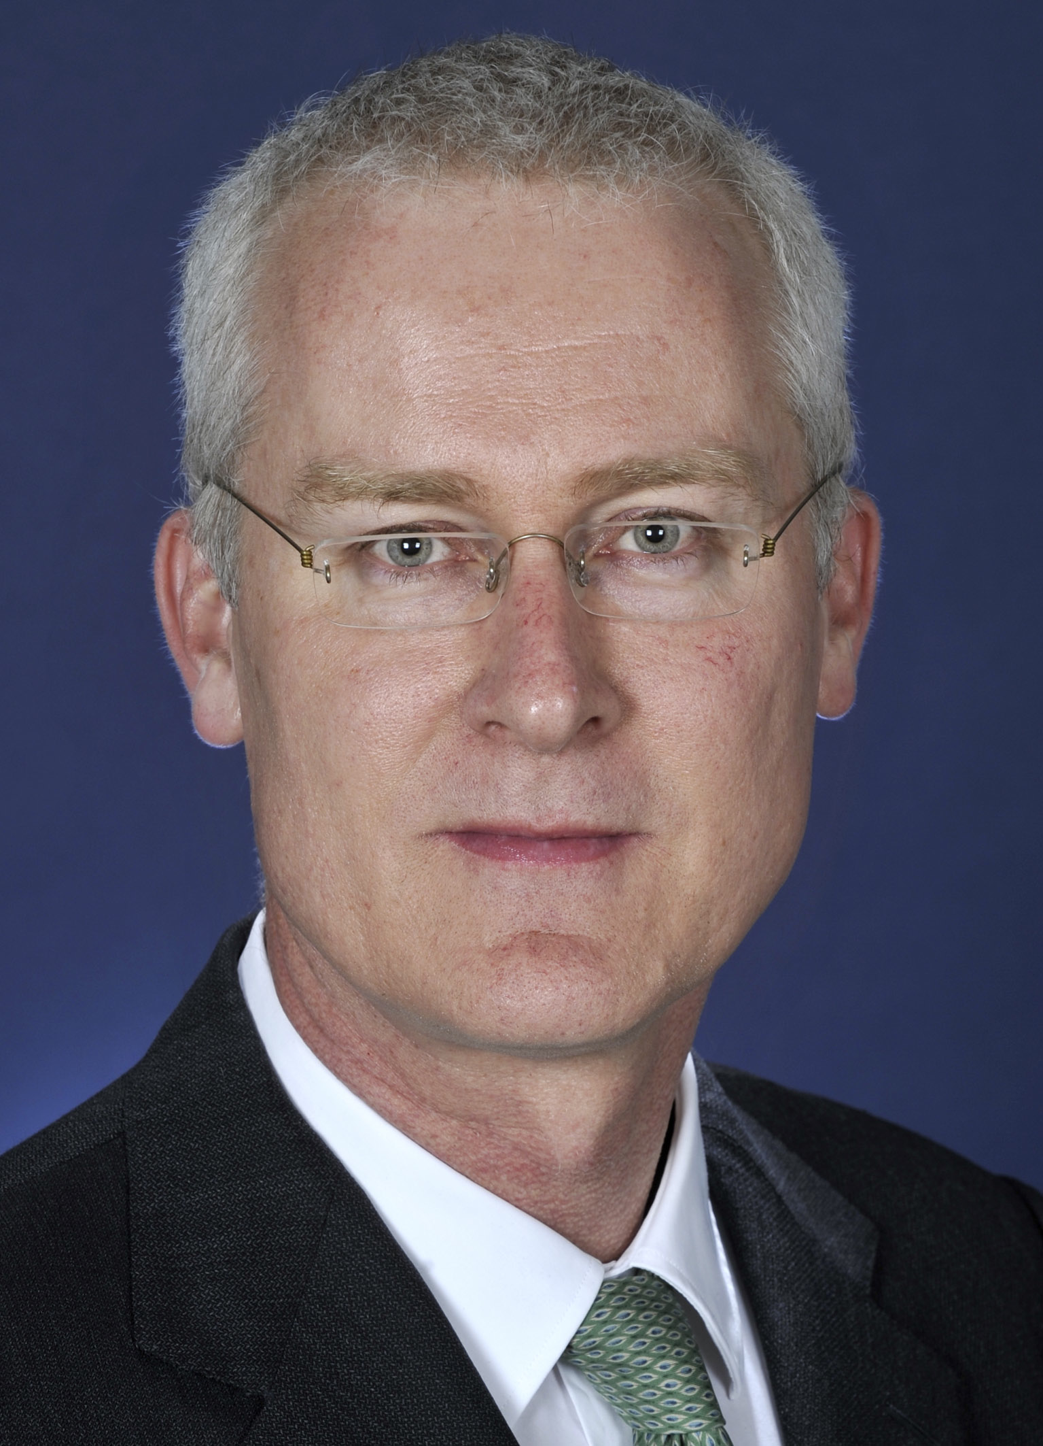
Introducing our former Ambassador
Mr Bruce Miller was Australian Ambassador to Japan 2011-2016.
Mr Miller was born and grew up in Sydney. He holds a Bachelor of Arts (first class honours) in Japanese language, literature and history together with a major in Government; and a Bachelor of Laws, both from the University of Sydney. He speaks Japanese fluently.

Slide 42
Japanese Sound System
 | w | r | y | m | h | n | t | s | k
 |  |  |  |  |  |  |  |  |  | a
 |  |  |  |  |  |  |  |  |  | i
 |  |  |  |  |  |  |  |  |  | u
 |  |  |  |  |  |  |  |  |  | e
n |  |  |  |  |  |  |  |  |  | o

Slide 43
Japanese Sound System
 | w | r | y | m | h | n | t | s | k
 | wa | ra | ya | ma | ha | na | ta | sa | ka | a
 |  | ri |  | mi | hi | ni | chi | shi | ki | i
 |  | ru | yu | mu | f/hu | nu | tsu | su | ku | u
 |  | re |  | me | he | ne | te | se | ke | e
n |  | ro | yo | mo | ho | no | to | so | ko | o

Slide 44
Japanese Writing System
Roman Characters: Roma-ji
Hiragana Syllabaries: ひらがな
Katakana Syllabaries: カタカナ
Kanji Characters: 漢字

Slide 45
ひらがな Hiragana
 | w | r | y | m | h | n | t | s | k
 | わ | ら | や | ま | は | な | た | さ | か | あ
 |  | り |  | み | ひ | に | ち | し | き | い
 |  | る | ゆ | む | ふ | ぬ | つ | す | く | う
 |  | れ |  | め | へ | ね | て | せ | け | え
ん | を | ろ | よ | も | ほ | の | と | そ | こ | お
https://www.youtube.com/watch?v=7I2Ryji_9Js&sns=em

Slide 46
Hiragana ひらがな schedule
Week 1 Recognise all individual ひらがな Week 2 Write all ひらがな
Read words in ひらがな
Week 3 Listen and write words/expressions in ひらがな
Week 4 Dictation quiz

Slide 47
Learn Hiragana ひらがな
Study the Textbook, Minato https://minato-jf.jp/
Practice using the Workbook
Making your own flashcards.
http://www.csus.edu/indiv/s/sheaa/projects/genki/hira_main.html
Post a Hiragana chart on your wall
https://www.google.com.au/search?q=%E3%81%B2%E3%82%89%E3%81%8C%E3%81%AA&hl=en&client=firefox-a&hs=2c5&rls=org.mozilla:en-GB:official&source=lnms&tbm=isch&sa=X&ei=76s2UY6rEIypkAWY3IHYBQ&ved=0CAoQ_AUoAQ&biw=1354&bih=850
Practice using Web link
http://www.csus.edu/indiv/s/sheaa/projects/genki/hiragana-timer.html
https://www.youtube.com/watch?v=8zfBMDNkJuI (my alter ego apears!)
Apps on smart phones
https://apps.ankiweb.net/
Post your learning strategies on Moodle Discussion page
Test each other among friends/classmates

Slide 48
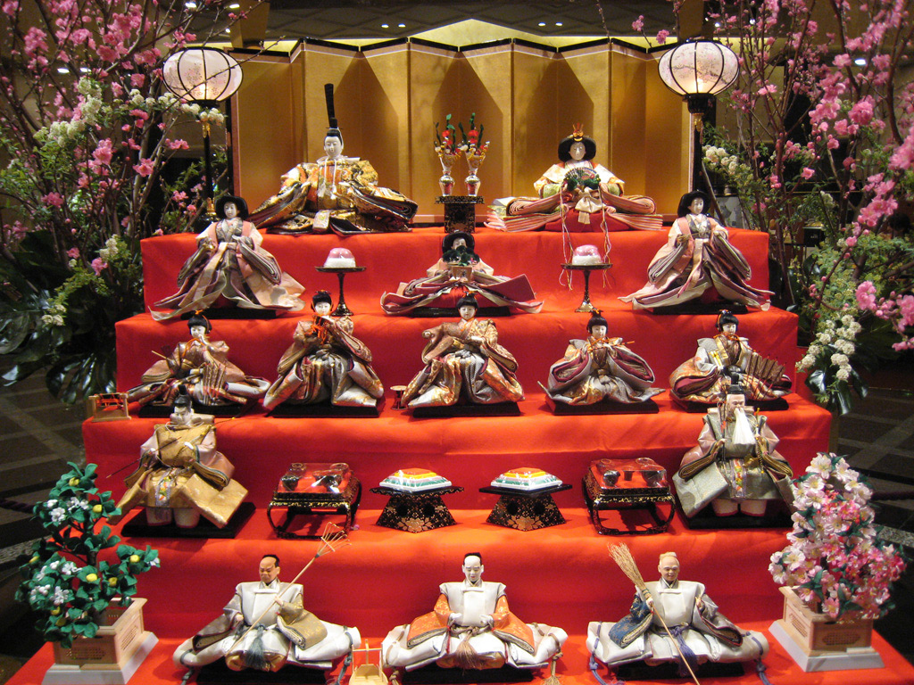

Slide 49
Hina matsuri ひなまつり
Doll’s festival (Girl’s festival)
March 3rd
Song “Ureshii hinamatsuri” うれしい ひなまつり
https://www.youtube.com/watch?v=fmcTkwDAMHE
How much?
http://www.yoshitoku.co.jp/
More info
http://japanese.about.com/library/weekly/aa022501a.htm
https://en.wikipedia.org/wiki/Hinamatsuri
http://web-japan.org/kidsweb/cool/13-02-18/
l

Slide 50
More expressions
もっとべんきょうしましょう

Slide 51
Good Morning
おはよう
ohayoo
hayoo
o
Check if all sounds are correct
Check if the rhythm is correct
Check if the pitch is correct

Slide 52
GOOD MORNING
おはようございます
ohayoo gozaimasu
hayoo gozaimasu
o
Check if all sounds are correct
Check if the rhythm is correct
Check if the pitch is correct

Slide 53
GOOD DAY
こんにちは。
kon’nichi wa
n’nichi wa
ko
Sound? Rhythm? Pitch?

Slide 54
GOOD EVENING
こんばんは。
konban wa
nban wa
ko
Sound? Rhythm? Pitch?

Slide 55

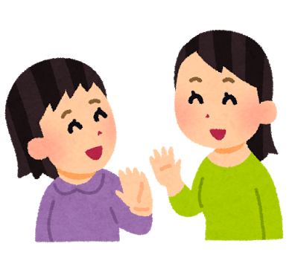
WELL THEN, SEE YOU LATER.
じゃあ また
jaa mata
ja ta
a ma
Sound? Rhythm? Pitch?

Slide 56

EXCUSE ME.(leave taking, interrupting someone, )
しつれい します
shitsuree shimasu
tsu
shi ree shimasu
Sound? Rhythm? Pitch?
https://www.erin.ne.jp/jp/lesson01/basic/index.html

Slide 57
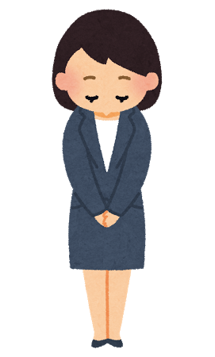
Excuse me.(sorry)
すみません
Sumimasen
mimase
su n
Sound? Rhythm? Pitch?
https://www.erin.ne.jp/jp/lesson01/basic/index.html

Slide 58
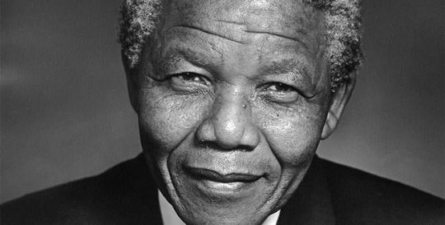
Why do we learn a new language?
“If you talk to a man in a language he understands, that goes to his head. If you talk to him in his language, that goes to his heart.”
Nelson Mandela

Slide 59
The aims of learning languages
The interrelated aims of learning languages are to:
communicate in the target language
understand language, culture, and to learn their relationship, and thereby develop an intercultural capability in communication
understand oneself as a communicator.
expand one’s identity as a multilingual speaker.

Slide 60
Understanding oneself? Good by =さようなら(sayoonara)？ 再見(zaijian) =さようなら(sayoonara)？
When?
How many times a day?
To whom?
Rice vs こめ（kome)
Learning a new language is about acquiring new conceptual knowledge and or modifying already existing knowledge as a way of re-mediating one’s interaction with the world and with one’s own psychological functioning. (Lantolf and Throne 2006, p.5)

Slide 61
Meeting, introducing, departing
A: こんにちは。[konnichiwa]
B: こんにちは。[konnichiwa]
A:はじめまして。[hajimemashite]
A です。[A desu] よろしく おねがい します。[yoroshiku onegai shimasu]
B:はじめまして。[hajimemashite]
B です。[B desu] よろしく おねがい します
[yoroshiku onegai shimasu]]
A: どうぞ。[doozo]
B: どうも。[doomo]
どうぞ。[doozo]
A: どうも。[doomo]
<looking at his/her watch>
じゃあ、また。 [jaa, mata]
B:しつれいします。 [shitsuree shimasu]
A: Hello
B: Hello
A: How do you do?
(I) Am “A”.
Nice to meet you.
B: How do you do?
(I) Am “B”.
Nice to meet you.
A: please.
B: thank you.
Please.
A: Thank you
<looking at his/her watch>
Well, then, see you.
B: Excuse me.

Slide 62
True or False ⭕️ ❌ (maru) (batsu)
You will see a question on the screen
I will say an answer choice
I will call “1,2,3 GO!” in Japanese
You will ALL show by hand “True or False” in one go
I will reveal the answer

Slide 63
Practice: When you call your teachers, you will say:

Slide 64
Before our next lecture (no tutorial this week)
Buy the textbook, workbook, and the course notes.
Check Moodle for the homework schedule and start your homework.
Access Moodle, download the course outline and read it thoroughly.
Download the Week 1 lecture PowerPoint and review the expressions
Learn to recognise all the Hiragana letters.
Practice writing Hiragana letters.
Preview Lesson 1.
Download the lecture PowerPoint for Week 2 and preview the slides (Thursday/Friday).

Slide 65
じゃあ、また。
Jaa mata
しつれいします。
Shitsuree shimasu

